Slide 1
CPS 109 - Lab 4

Slide 2
Agenda
Today we’re going to talk even more about functions.
One might say I really love functions.
One might also say I put the fun in functions.
One probably wouldn’t say I describe functions with unction (though it could be argued)...

Slide 3
Functions
I have already drilled functions into your heads, but let’s look at their syntax once more.
Here you have “def”, the name of your function and whatever arguments you need.

Slide 4


Functions
In Python, functions usually have one or more print or return statements:

Slide 5
Functions
Why do we use functions? Well, for a couple of reasons:
It saves us from not having to write the same code over and over again.
Programs will run very predictably when we call functions.
It makes our programs substantially easier to read.

Slide 6
Functions
Functions should do exactly one thing. Examples may include searching a list, or printing some numbers. Functions up until now have had just code plopped in there.
Now, when you make a function, it should only do one thing.

Slide 7
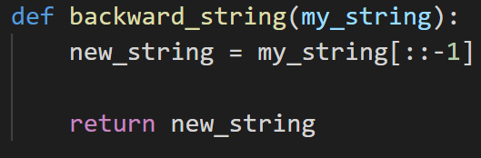
Functions
A simple function (to remind ourselves of function structure):

Slide 8
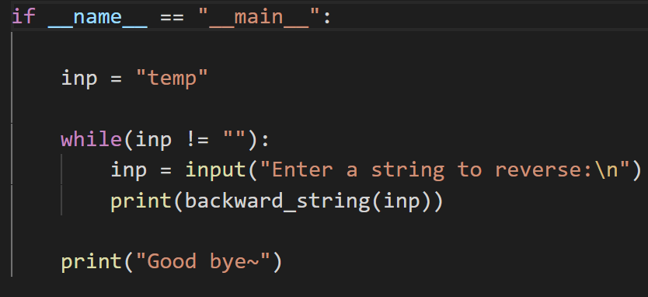
Functions
Now let’s call the function in the main:

Slide 9

Functions
Something’s weird about how we call print, right?
We’re passing a function as an argument for another function! Why are we able to do that?

Slide 10
Functions
Well, remember our function definition on the last slide?
Notice how it returns new_string.

Slide 11
Functions
Since the computer knows what instructions to execute and the value of the argument fed into the function, it knows the return value. Meaning that:

Slide 12
Functions
What do we do with this information? Well, that means that we can feed functions into other functions as much as we want! This includes functions we’ve defined.

Slide 13
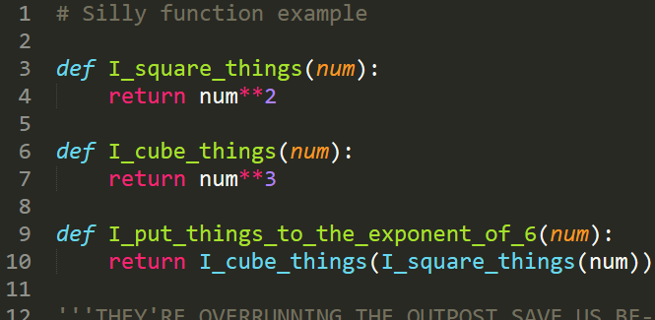
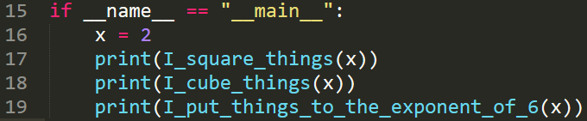
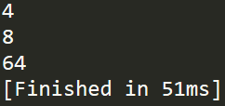
Nested Functions
Fun fact: the sixth power was also dubbed the “zenzicube” by the inventor of the = sign
Notes:
https://en.wikipedia.org/wiki/Sixth_power#:~:text=In%20the%20archaic%20notation%20of,the%20cube%20of%20a%20square.

Slide 14
Functions
One more thing about functions before we go through some examples: anything you can write that functions as code (for loops, while loops, if statements, etc.) can (and should!) be put into a function.
Remember: good code is neat code.

Slide 15
Questions?

